Slide 1


Slide 2
Artificial Neural Network basics
Qingkai Kong
2016-12-02
http://seismo.berkeley.edu/qingkaikong/

Slide 3
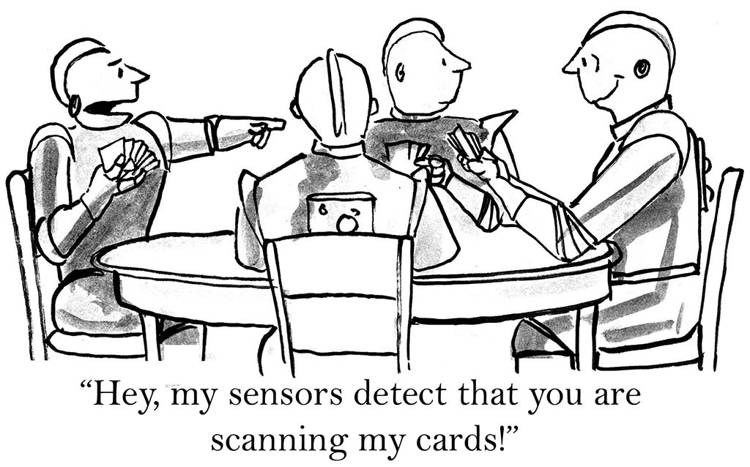

Slide 4
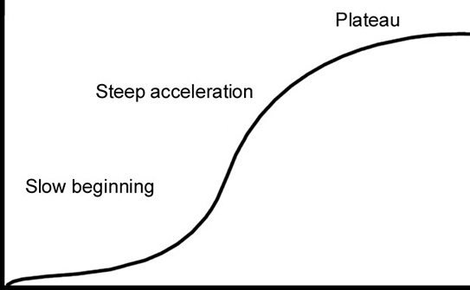
Real world example
Step by step ANN
Learning curve
Gentle introduction
Workshop time

Slide 5
Real world example
Step by step ANN
Learning curve
Gentle introduction
What’s ML
ANN history
ANN overview
Workshop time

Slide 6

What is machine learning?

Slide 7
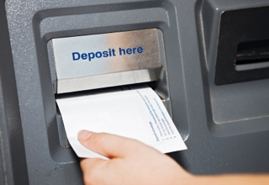



Self-driving car
Voice recognition
…

Slide 8
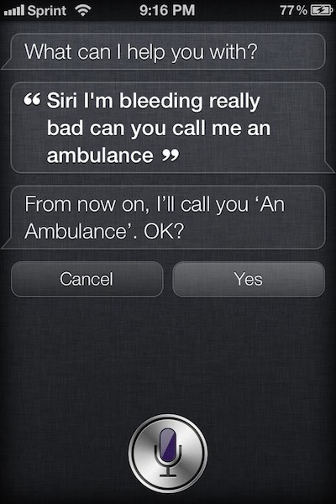
Not always working

Slide 9
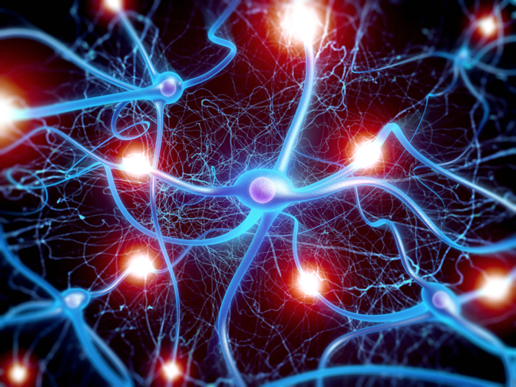

Slide 10
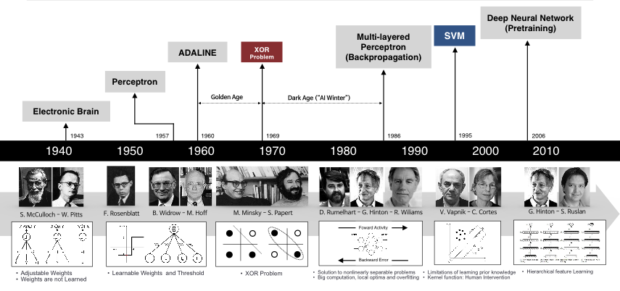
1980s
Rebirth
2006
Deep
1970s
Winter
1940s
Birth

Slide 11
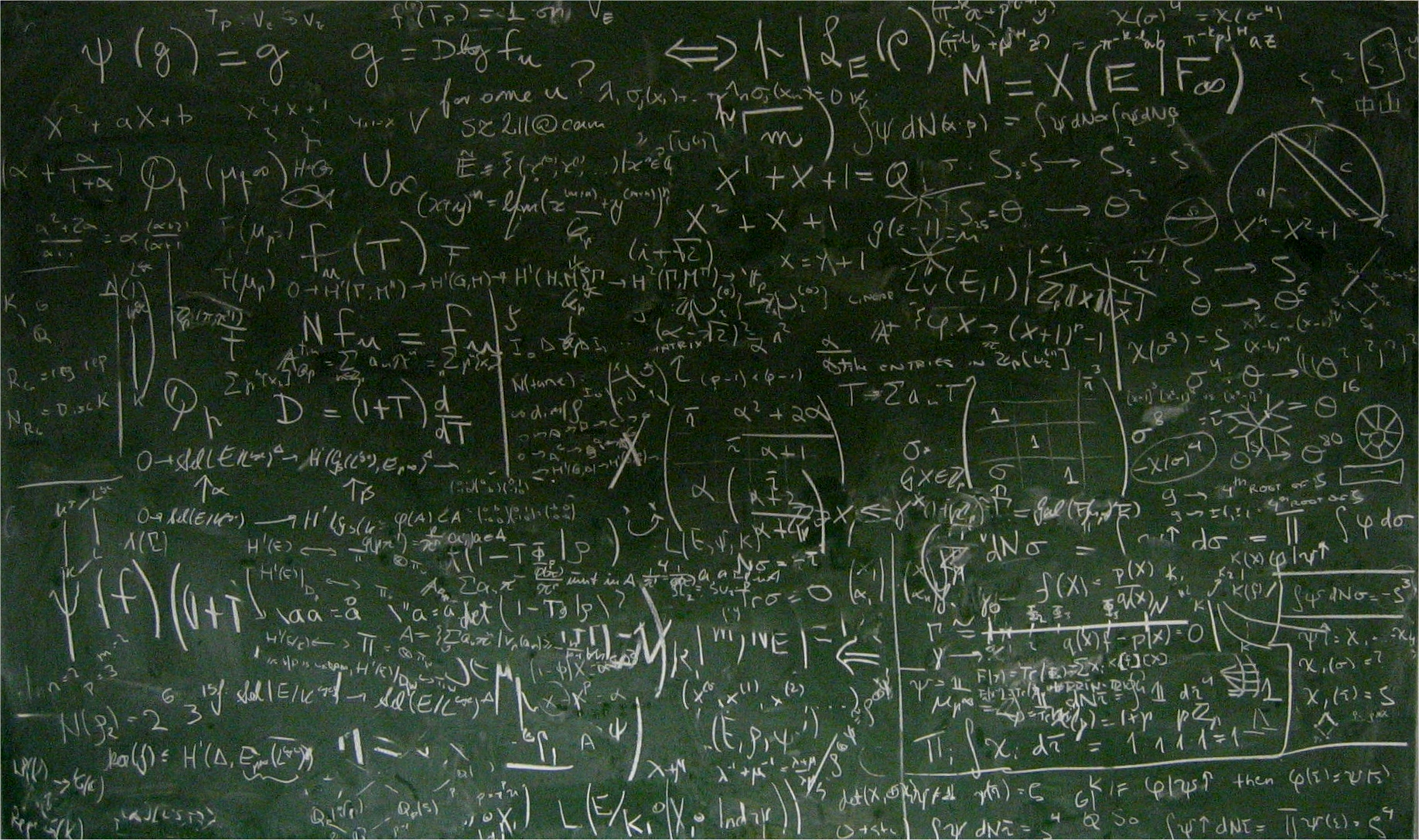


Slide 12
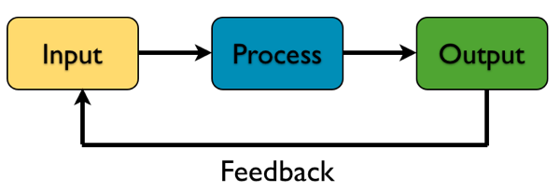
ANN in simple view

Slide 13
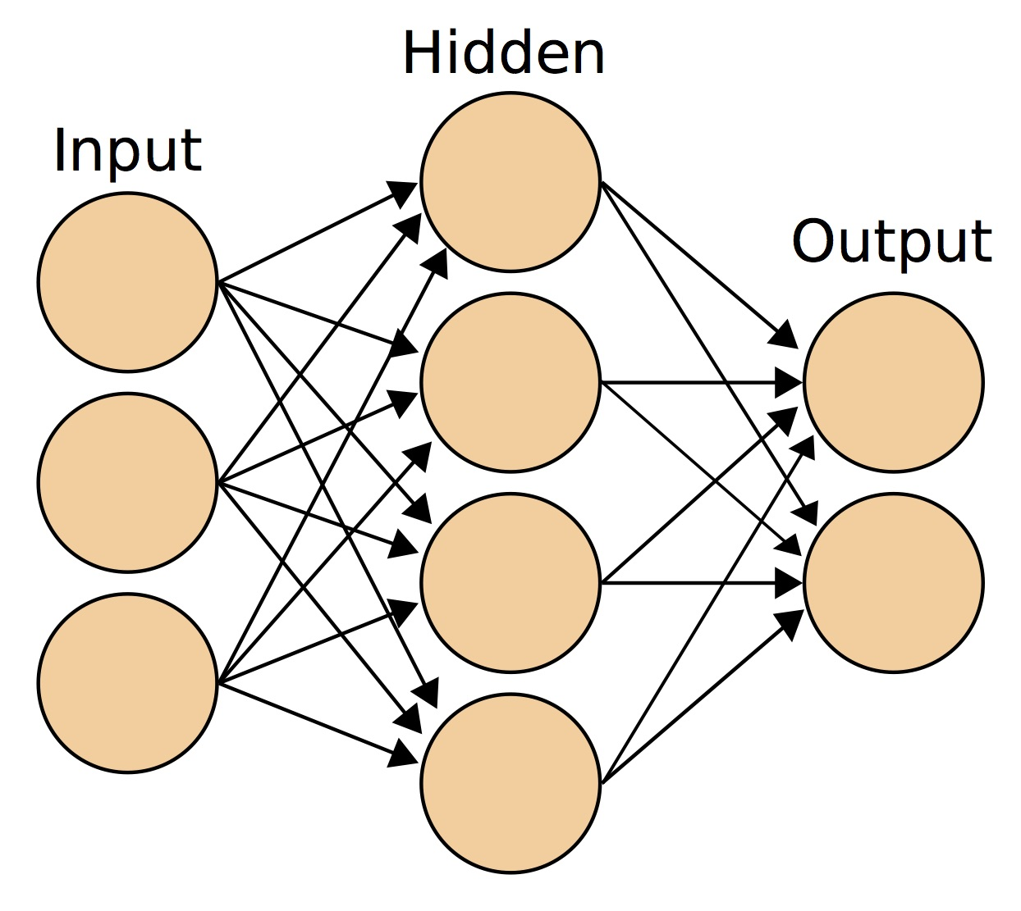
ANN jargons
Notes:
It's a mathematical construct to fit a model to historical data, and use this model to forecast the future.

Slide 14

What’re the weights

Slide 15
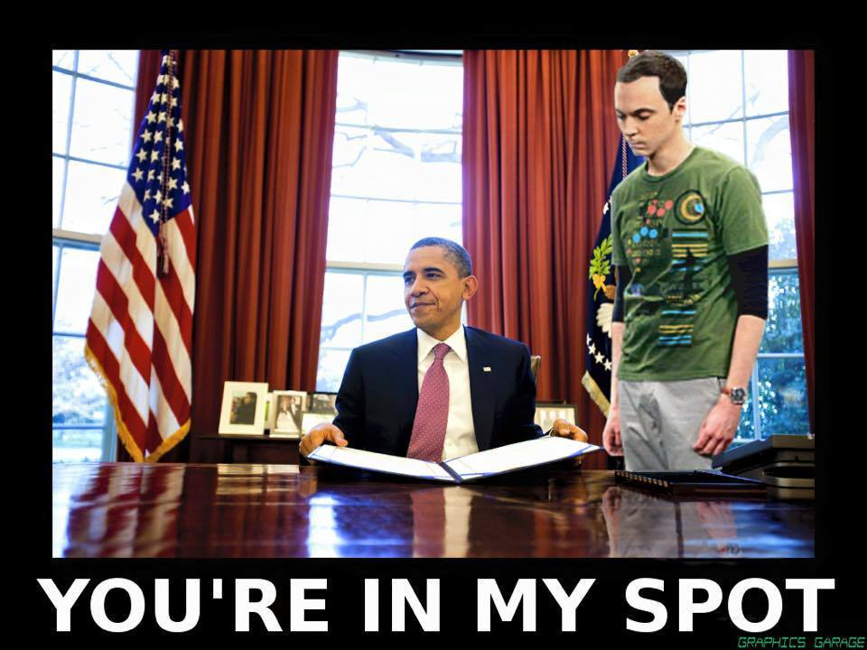

Slide 16

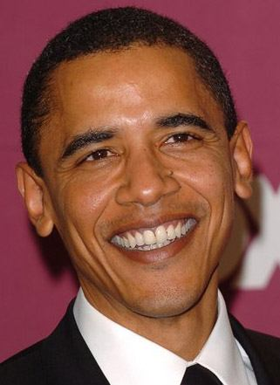
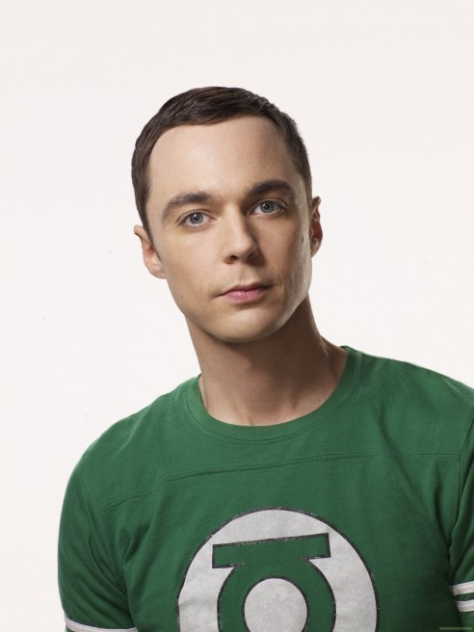
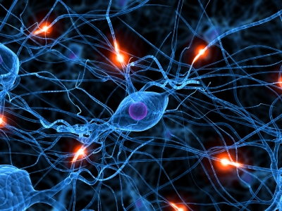
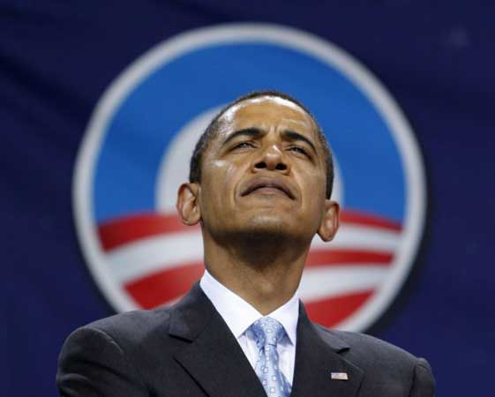
Intuitive Artificial Neural Network
Input
Output
w₁
F(eye×w₁+nose×w₂+…+mouth×w_{n})
w₂
Sheldon Cooper?
.
.
.
w_{n}

Slide 17

Intuitive Artificial Neural Network
Input
Output
w₁
F(eye×w₁+nose×w₂+…+mouth×w_{n})
w₂
Sheldon Cooper?
.
.
.
w_{n}
error
feedback

Slide 18
Intuitive Artificial Neural Network
Input
Output
w₁
F(eye×w₁+nose×w₂+…+mouth×w_{n})
w₂
Sheldon Cooper?
.
.
.
w_{n}
error
feedback

Slide 19
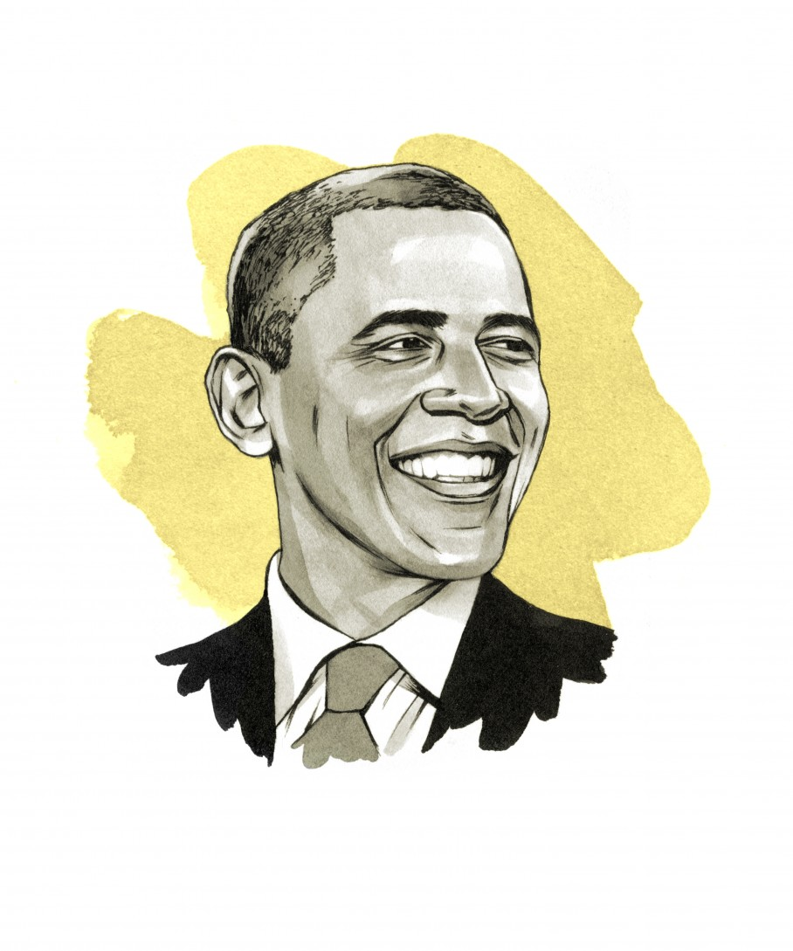
Intuitive Artificial Neural Network
Input
Output
w₁
F(eye×w₁+nose×w₂+…+mouth×w_{n})
w₂
.
.
.
w_{n}

Slide 20
Real world example
Step by step ANN
Perceptron
Backpropagation
Learning curve
Gentle introduction
What’s ML
ANN history
ANN overview
Workshop time

Slide 21


Slide 22

Application: Learn arts
https://arxiv.org/abs/1508.06576v1
https://deepart.io/

Slide 23
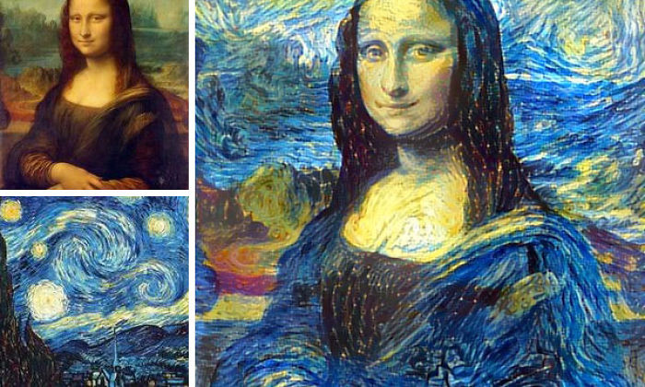
http://junkhost.com/2016/03/man-combines-random-peoples-photos-using-neural-networks-and-the-results-are-amazing/

Slide 24
Input
1
ω₀
X
Output
ω₁
feature1
Σ
f
y
ω₂
ω₃
X – input data
y – output target
ω_{i} – weights
Σ – summation
f – activation function
Blue circle – bias
feature2
feature3
Σ = ω₀x₀+ω₁x₁+ω₂x₂+ω₃x₃+…+ω_{n}x_{n}
f = f(ω₀x₀+ω₁x₁+ω₂x₂+ω₃x₃+…+ω_{n}x_{n})

Slide 25
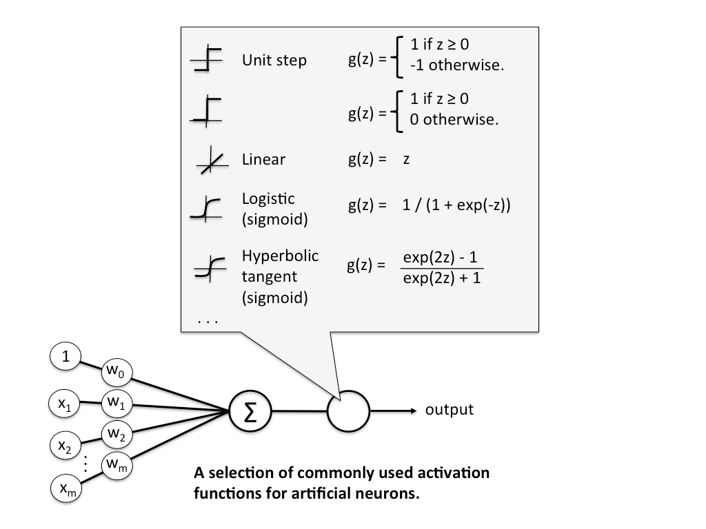

Slide 26
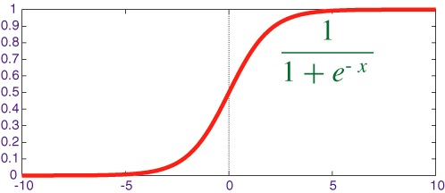
More activation function
z = ω₀x₀+ω₁x₁+ω₂x₂+ω₃x₃+…+ω_{n}x_{n}

Slide 27
Input
1
ω₀
X
Output
ω₁
feature1
Σ
f
y
ω₂
ω₃
X – input data
y – output target
ω_{i} – weights
Σ – summation
f – activation function
Blue circle – bias
feature2
feature3
Σ = ω₀x₀+ω₁x₁+ω₂x₂+ω₃x₃+…+ω_{n}x_{n}
f = f(ω₀x₀+ω₁x₁+ω₂x₂+ω₃x₃+…+ω_{n}x_{n})
y = f (This is our estimation)

Slide 28
Input
1
ω₀
X
Output
ω₁
feature1
Σ
f
y
ω₂
ω₃
X – input data
y – output target
ω_{i} – weights
Σ – summation
f – activation function
Blue circle – bias
feature2
feature3
Error = Target - Estimation

Slide 29


Slide 30
How to update weights
Error = Target - Estimation

Slide 31
How to update weights
Error = Target - Estimation
Learning:
Update weights to reduce error next time!

Slide 32


Slide 33
Look at errors closer
Error = Target - Estimation
Target
0
1

Slide 34
Look at errors closer
Error = Target - Estimation
Target
0
1
Three cases:
Error < 0: Target is 0, estimation is not 0
Error > 0: Target is 1, estimation is not 1
Error = 0: Estimation correct

Slide 35
Look at errors closer (assume inputs are positive)
Cases 1:
Error < 0: Target is 0, estimation is not 0

Slide 36

Look at errors closer (assume inputs are positive)
Cases 1:
Target is 0
Estimation is 0.3
Error = 0 – 0.3 =-0.3

Slide 37
Look at errors closer (assume inputs are positive)
Cases 1:
Target is 0
Estimation is 0.3
Error = 0 – 0.3 =-0.3
z_{update}
z

Slide 38
Look at errors closer (assume inputs are positive)
Cases 1:
Target is 0
Estimation is 0.3
Error = 0 – 0.3 =-0.3
z = ω₀x₀+ω₁x₁+ω₂x₂+ω₃x₃
We need reduce weights!

Slide 39
Look at errors closer (assume inputs are positive)
Cases 1:
Target is 0
Estimation is 0.3
Error = 0 – 0.3 =-0.3
z = ω₀x₀+ω₁x₁+ω₂x₂+ω₃x₃
We need reduce weights!
If we add error to the weights, we will reduce it!

Slide 40
Look at errors closer (assume inputs are positive)
Cases 1:
Target is 0
Estimation is 0.3
Error = 0 – 0.3 =-0.3
z = ω₀x₀+ω₁x₁+ω₂x₂+ω₃x₃
We need reduce weights!
But what if the inputs are negative

Slide 41
Weights update rules
Weights Delta = Error × input

Slide 42
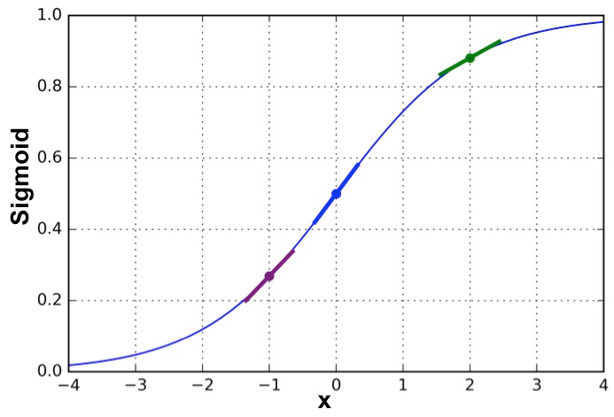
z

Slide 43
flat slope
steep slope
z

Slide 44
Weights update rules
Weights Delta = Error × slope × input

Slide 45
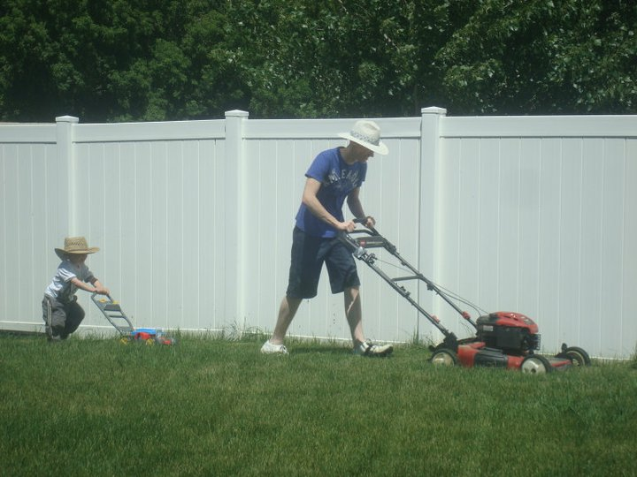
Learn from example

Slide 46
Learn from Example
Sample | Feature 1 | Feature 2 | Feature 3 | Target
Sample 1 | 0 | 0 | 1 | 0
Sample 2 | 1 | 1 | 1 | 1
Sample 3 | 1 | 0 | 1 | 1
Sample 4 | 0 | 1 | 1 | 0
Sample 5 | 1 | 0 | 0 | 1

Slide 47
How to deal with errors
Sample | Feature 1 | Feature 2 | Feature 3 | Target
Sample 1 | 1 | 1 | 1 | 1
Input
1
X
-0.166
Output
0.441
1
Σ
f
y
-1.000
1
-0.395
Σ = (-0.166)×1 + 0.441×1 + (-1)×1 + (-0.395)×1
= -1.12
f(-1.12) = 1/(1+e^{-1.12}) = 0.246
Error = 1 – 0.246 = 0.754
1

Slide 48
Target: 1
Estimation: 0.246
Error 0.754
z
z_{update}

Slide 49
Target: 1
Estimation: 0.246
Error 0.754
z
z_{update}
We want to increase the weights next time to have larger z

Slide 50
Weights delta = 0.754 × slope × input

Slide 51
z = -1.12 f(z) = 0.246
slope = 0.246 × (1 - 0.246) = 0.185
z

Slide 52
1
1
1
1
Change item = 0.754 × 0.185 ×
0.139
0.139
0.139
0.139
=

Slide 53
Changes of the error
-0.166
0.441
-1.000
-0.395
0.139
0.139
0.139
0.139
-0.027
0.580
-0.861
-0.256
Updated
Weights
=
+
=
Original
Weights
updates

Slide 54
Changes of the error
-0.166
0.441
-1.000
-0.395
0.139
0.139
0.139
0.139
-0.027
0.580
-0.861
-0.256
Updated
Weights
=
+
=
Error of next iteration
z = (-0.027)×1 + 0.580×1 + (-0.861)×1 + (-0.256) ×1 = -0.564
f(z) = 0.637
Error = 1 – 0.637 = 0.363

Slide 55

Changes of the error
0.754
0.363

Slide 56

Iterate many times

Slide 57
Go to notebook 01

Slide 58
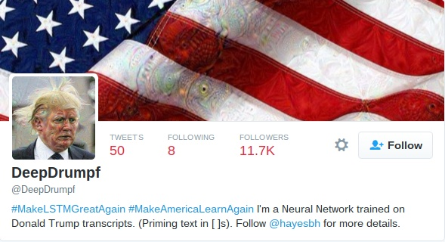
Application: DeepDrumpf
https://twitter.com/DeepDrumpf

Slide 59
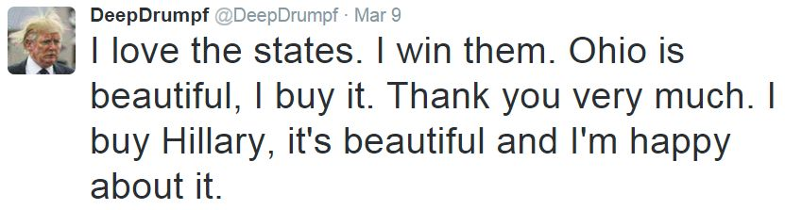
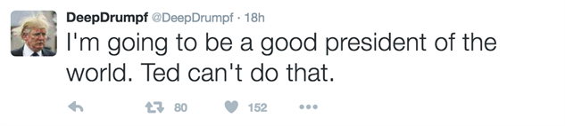

Slide 60
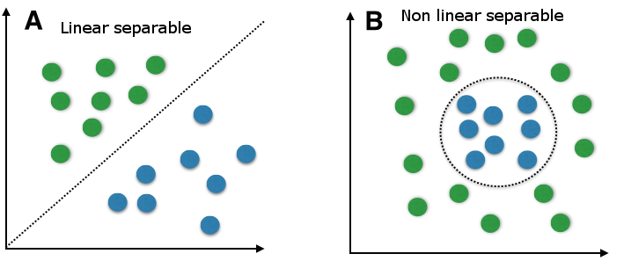
Perceptron limitations

Slide 61

Winter of ANN

Slide 62
Multi-Layer Perceptron

Slide 63
Input
1
1
Hidden1
Σ | f
X
Output
feature1
Hidden2
Σ | f
Σ
f
y
feature2
Hidden3
Σ | f
X – input data
y – output target
Σ – summation
f – activation function
blue circle - bias
feature3
Hidden4
Σ | f

Slide 64
Input
1
1
Hidden1
Σ | f
X
Output
feature1
Hidden2
Σ | f
Σ
f
y
feature2
Hidden3
Σ | f
X – input data
y – output target
Σ – summation
f – activation function
blue circle - bias
feature3
Hidden4
Σ | f

Slide 65
Input
1
1
Hidden1
Σ | f
X
Output
feature1
Hidden2
Σ | f
Σ
f
y
feature2
Hidden3
Σ | f
X – input data
y – output target
Σ – summation
f – activation function
blue circle - bias
feature3
Hidden4
Σ | f

Slide 66
Go to notebook 02

Slide 67
Real world example
Sklearn example
Step by step ANN
Perceptron
Backpropagation
Learning curve
Gentle introduction
What’s ML
ANN history
ANN overview
Workshop time

Slide 68
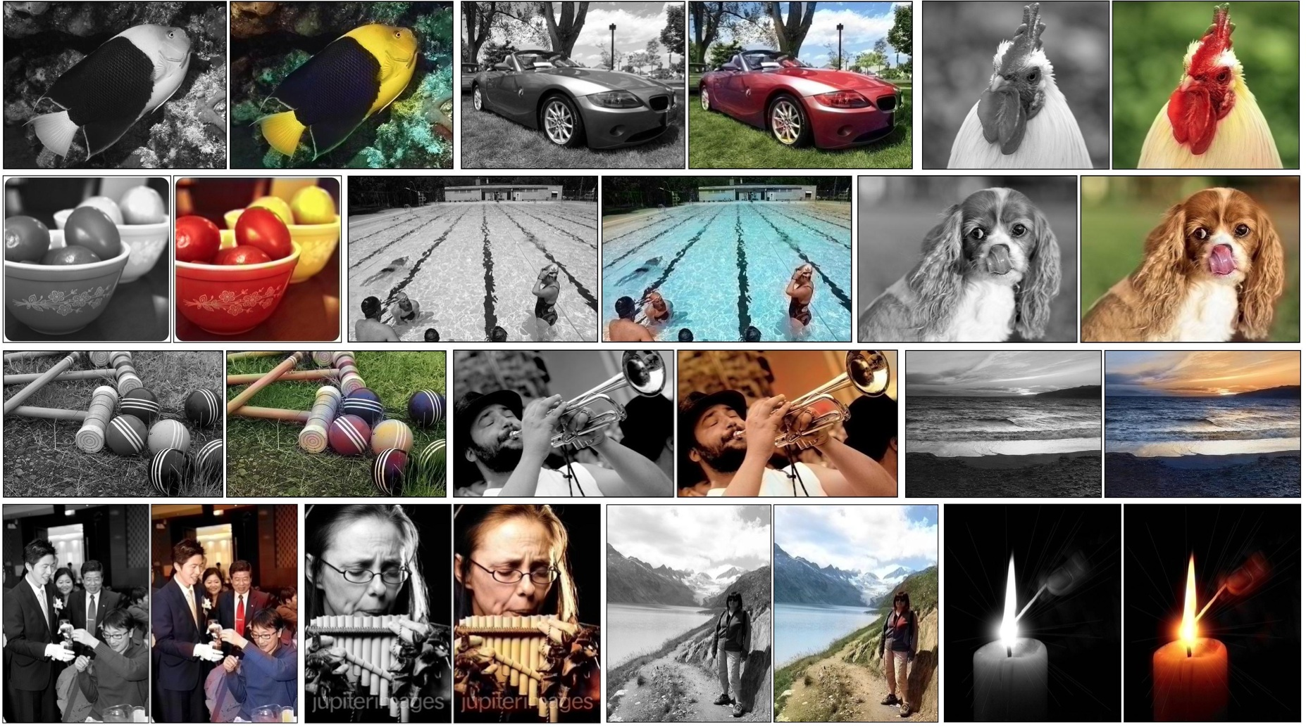
Application: Colourization
http://whattogive.com/videoColourization/
http://richzhang.github.io/colorization/

Slide 69
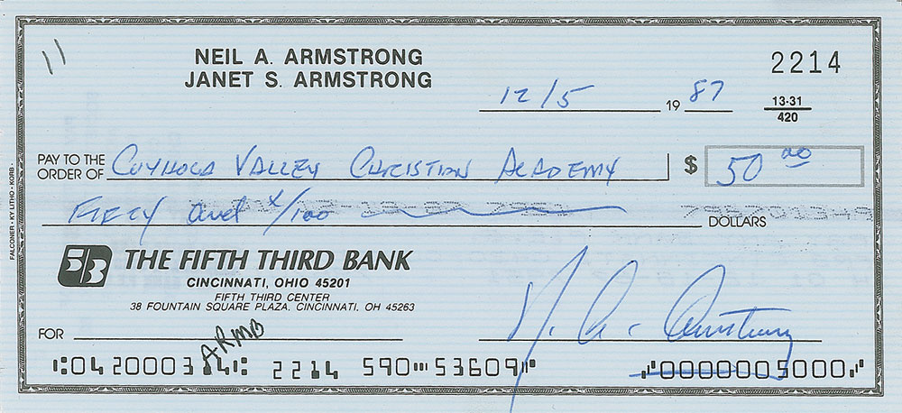

Slide 70
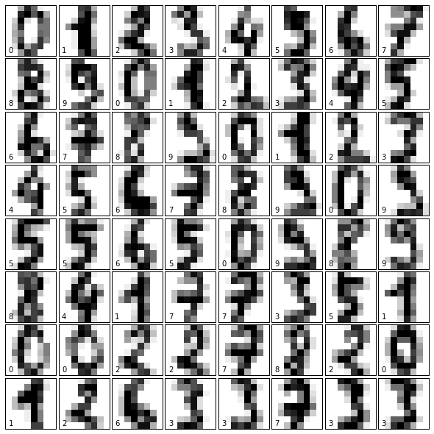

Slide 71
Go to notebook 03

Slide 72


Slide 73
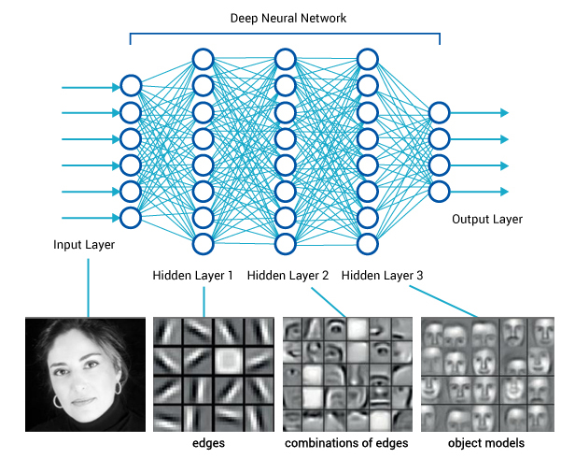

Slide 74
Some useful resources
http://iamtrask.github.io/2015/07/12/basic-python-network/
https://seat.massey.ac.nz/personal/s.r.marsland/MLBook.html
http://sebastianraschka.com/Articles/2015_singlelayer_neurons.html
http://www.emergentmind.com/neural-network
http://neuralnetworksanddeeplearning.com/
You can also find most of today’s workshop material on my blog:
http://qingkaikong.blogspot.com/2016/10/machine-learning-1-what-is-machine.html

Slide 75


